Slide 1
Happiness vs indicators
Group: Fab 5
Seth
Ryan
Mona
Mendie
Dawn

Slide 2
Contents
Study design
Data sets and questions asked
Motivation and inspiration
GDP, Life Expectancy, and Freedom regression analysis
Happiness and GDP trends
Happiness indicators by country
Infant mortality and Literacy scatter plots
Happiness map and score guage
Conclusion

Slide 3
Happiness vs Indicators
- Is there a correlation between happiness and the following indicators:
GDP per capita, Freedom, Life expectancy, Infant mortality %, Literacy %
- Our goal is to determine if happiness is determined in part by several indicators of data gathered in the study. In other words, what makes people happy?
-We used data from the World Happiness Report as well as The World Bank world development indicators.
Notes:
QuickStarter has created an outline to help you get started on your presentation. Some slides include information here in the notes to provide additional topics for you to research.

Slide 4
Datasets
Used and Questions Asked
Datasets:
World Happiness Report
  Happiness score, GDP per capita, Life expectancy, and Freedom
World Bank
- Infant mortality and Literacy %
Questions asked:
Which indicators influence happiness and which has the greatest impact?
Do GDP per capita, freedom, life expectancy, literacy %, and infant mortality correlate with happiness?
Does being in a certain region [continent] have any correlation to the average score of countries?

Slide 5
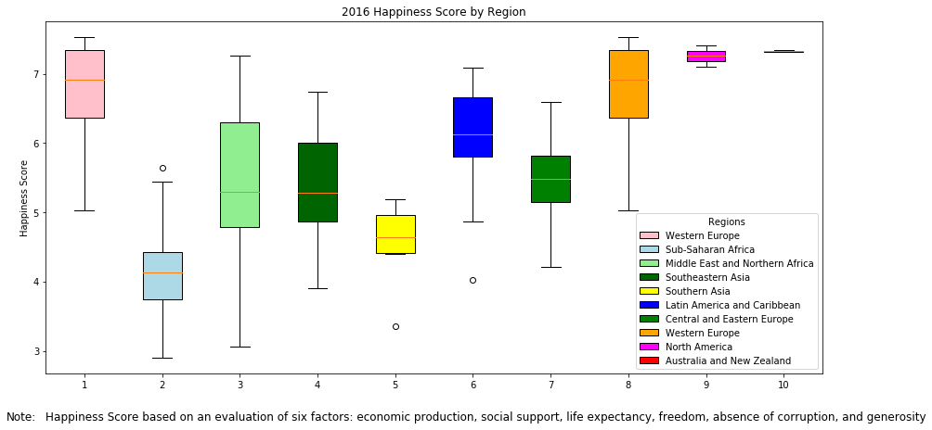
Motivation and Inspiration
Project goal: to study and analyze datasets to answer the question of what really goes into a country’s overall happiness.
Happiness Defined: our dataset took nationally representative samples of respondents from each country. Questions asked were based on The Cantril Ladder, which asks respondents to subjectively evaluate their life based their unique facts and circumstances.
How do variables like GDP and Freedom factor into a country’s overall happiness?
Notes:
See Appendix example 1 for Box Plot programming

Slide 6
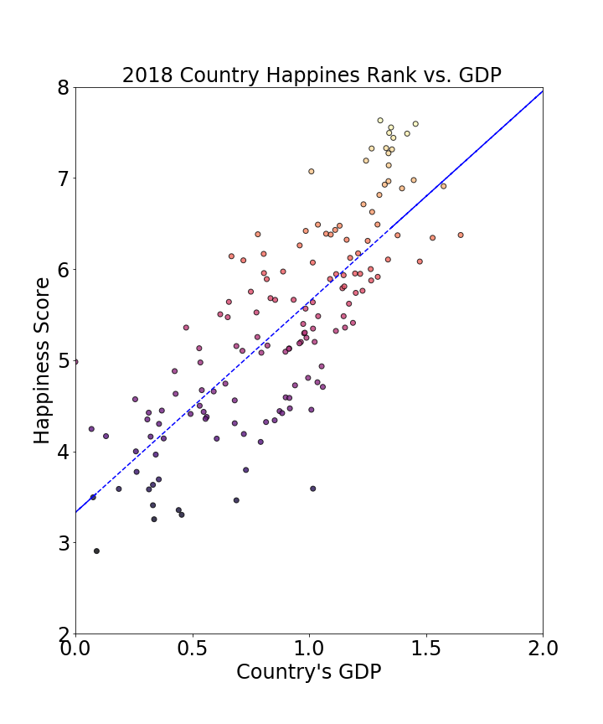
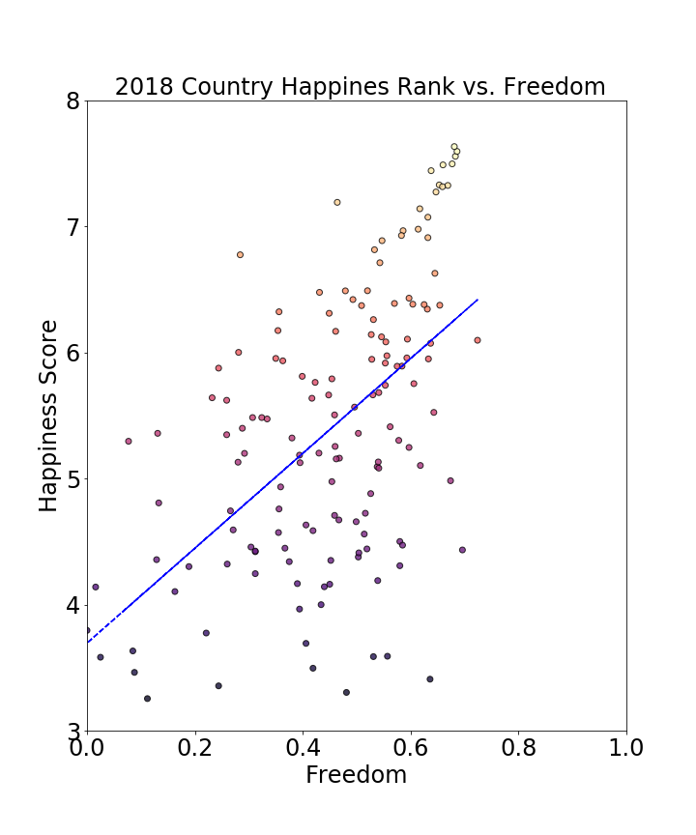
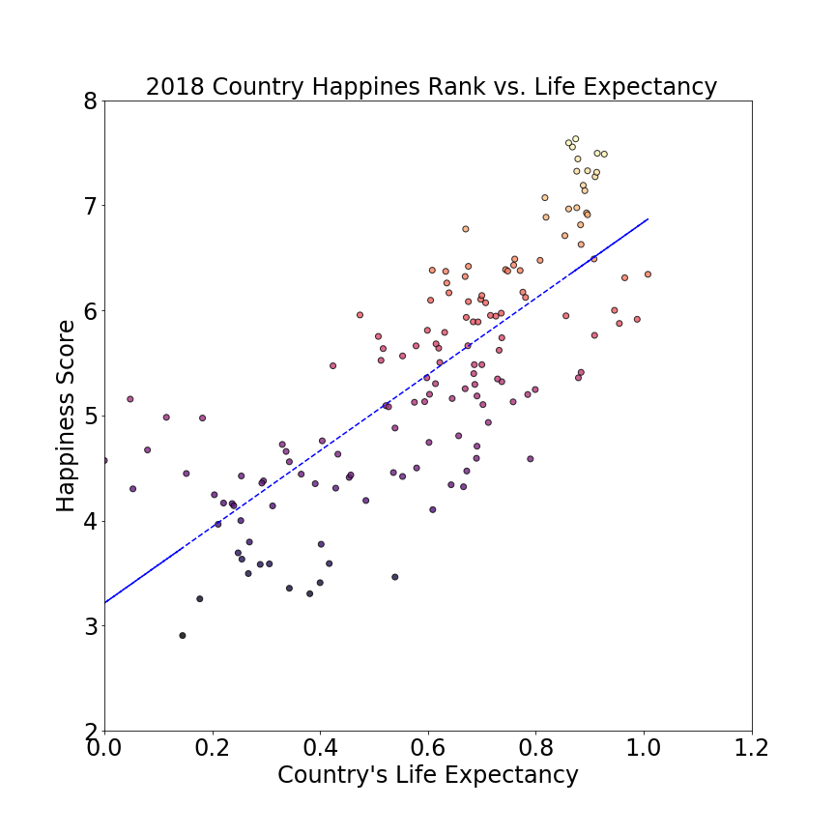
Happiness vs GDP, Life Expectancy and Freedom
Reviewing 2018 data Country Happiness Score vs. GDP, Freedom and Life Expectancy it would appear GDP has a higher correlation to happiness
Source: 2018 Happiness report found on Kaggle.com
Notes:
Talking points:
- Interesting that GDP has such a higher correlation to happiness but……
Obviously not enough data to really come to a solid conclusion, could be many other factors that drives happiness but going with what data we had.
Tried to gather temperature data from World Bank to have an API source but the website was broken. That would have been an interesting data point as well
Temp
Population
Hrs Worked
Crime
Could have also calculated Chi Squared calculation as well

Slide 7
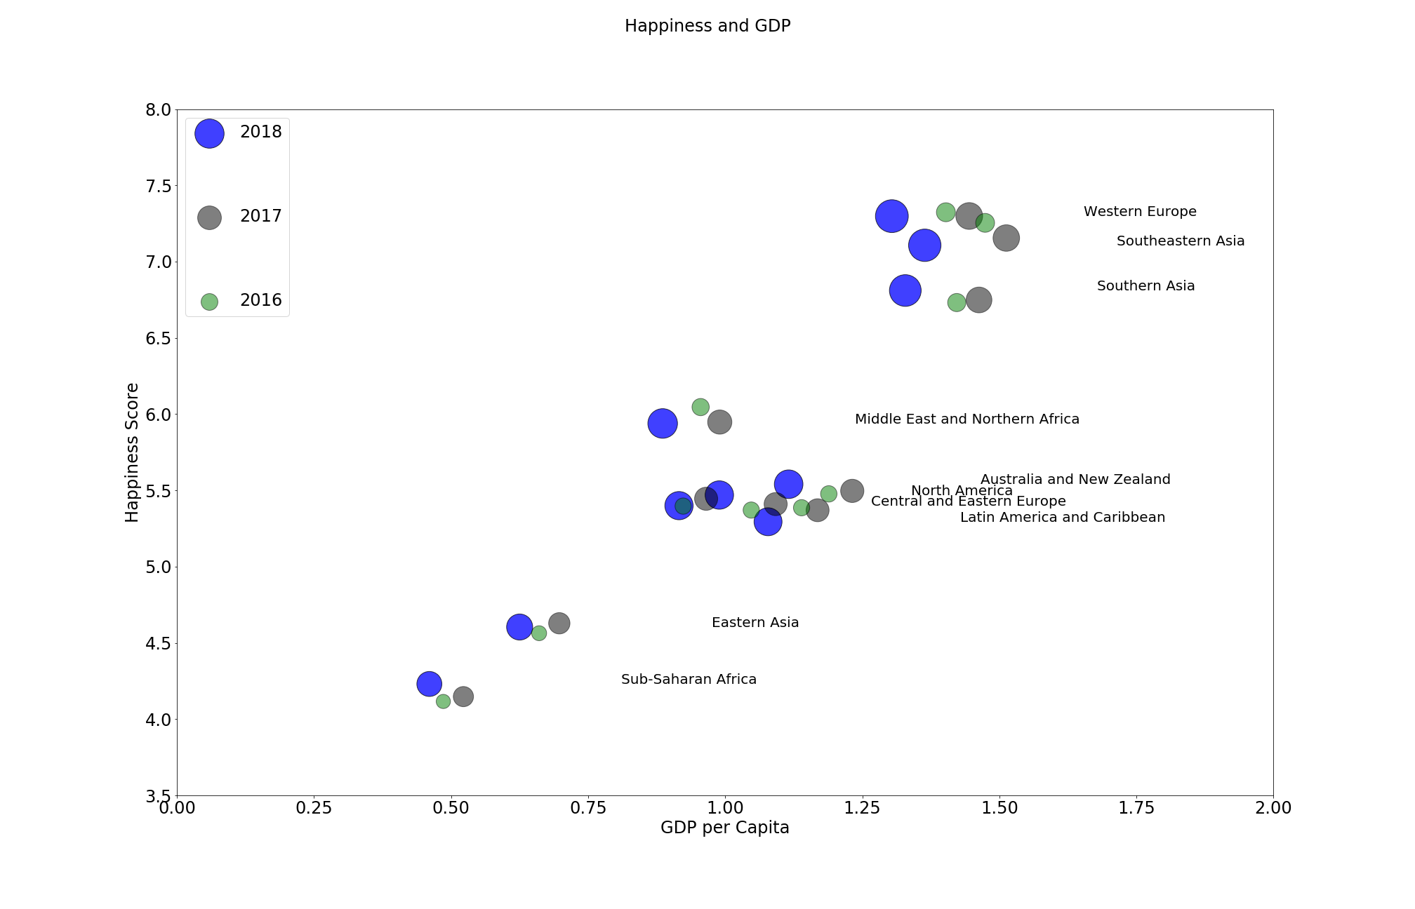
Happiness and GDP trends
Happiness Scores and GDP 2016-2018
GDP declined in every region in 2018
Happiness scores increased or stayed consistent however
While GDP is an important contributor to the happiness scores it is not the only driver
Notes:
Talking points:
Bubble graph similar to what we did in the PyUber exercise- added labels next to bubbles for identification, made box wider so bubbles weren’t too close together
Good visualization to see trends of a lot of data

Slide 8
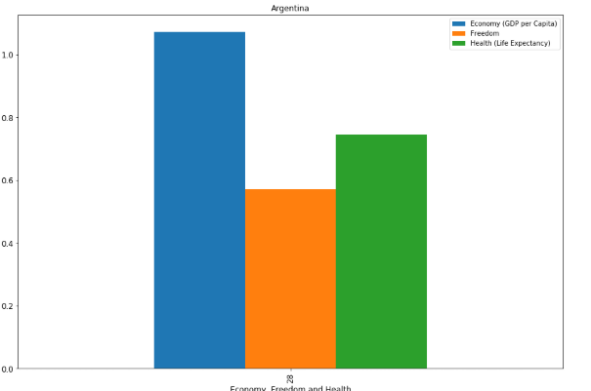
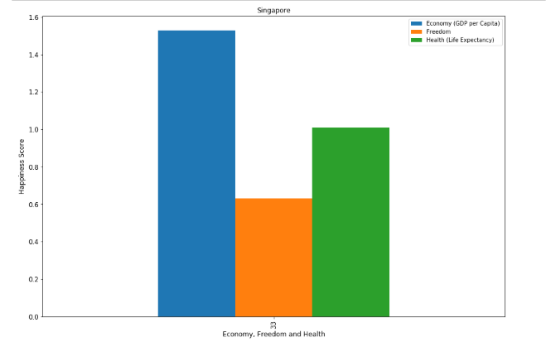
2018 Happiness Indicators per Country
Provide users with option to see Happiness by Indicator for a selected country
Drop down list feature prompts user to enter a specific country
Notes:
Talking point:
- Do demo in Jupyter

Slide 9
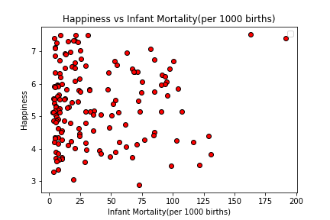
Happiness and Infant Mortality
- Scatter plot showing happiness score vs. infant mortality rate per 1000 births
- Each red circle represents a country
- Analysis of the data shows no clear correlation between infant mortality rate and happiness score of a country.

Slide 10
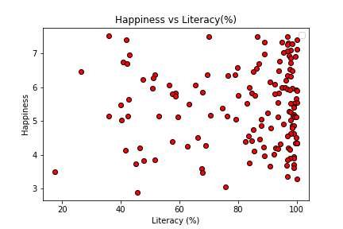
Happiness and Literacy
- Scatter plot showing happiness score vs literacy %
- Each red circle represents a country
- Analysis of the data shows no clear correlation between literacy and a country’s happiness score

Slide 11
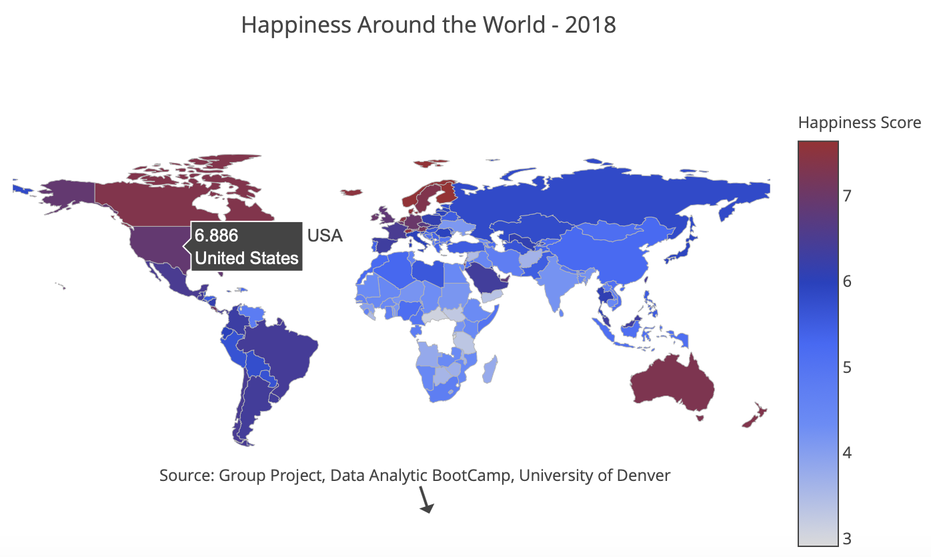
Happiness Around the World
Here’s a world map color-coded by each country’s overall happiness score in 2018.
-The darker the red, the higher the happiness score. The happiest regions of the world appear to be in Europe, North and South America, Australia and New Zealand. Africa appears to contain the lowest overall happiness scores.
Notes:
Talking points:
-Here’s a world map color-coded by each country’s overall happiness score in 2018.
-The darker the red, the higher the happiness score. The happiest regions of the world appear to be in Europe, North and South America, Australia and New Zealand. Africa appears to contain the lowest overall happiness scores.
- Lessons learned- found pyplot to be the most efficient tool to create a choropleth. Note you must sign-up on pyplot.com to be able to run the code

Slide 12
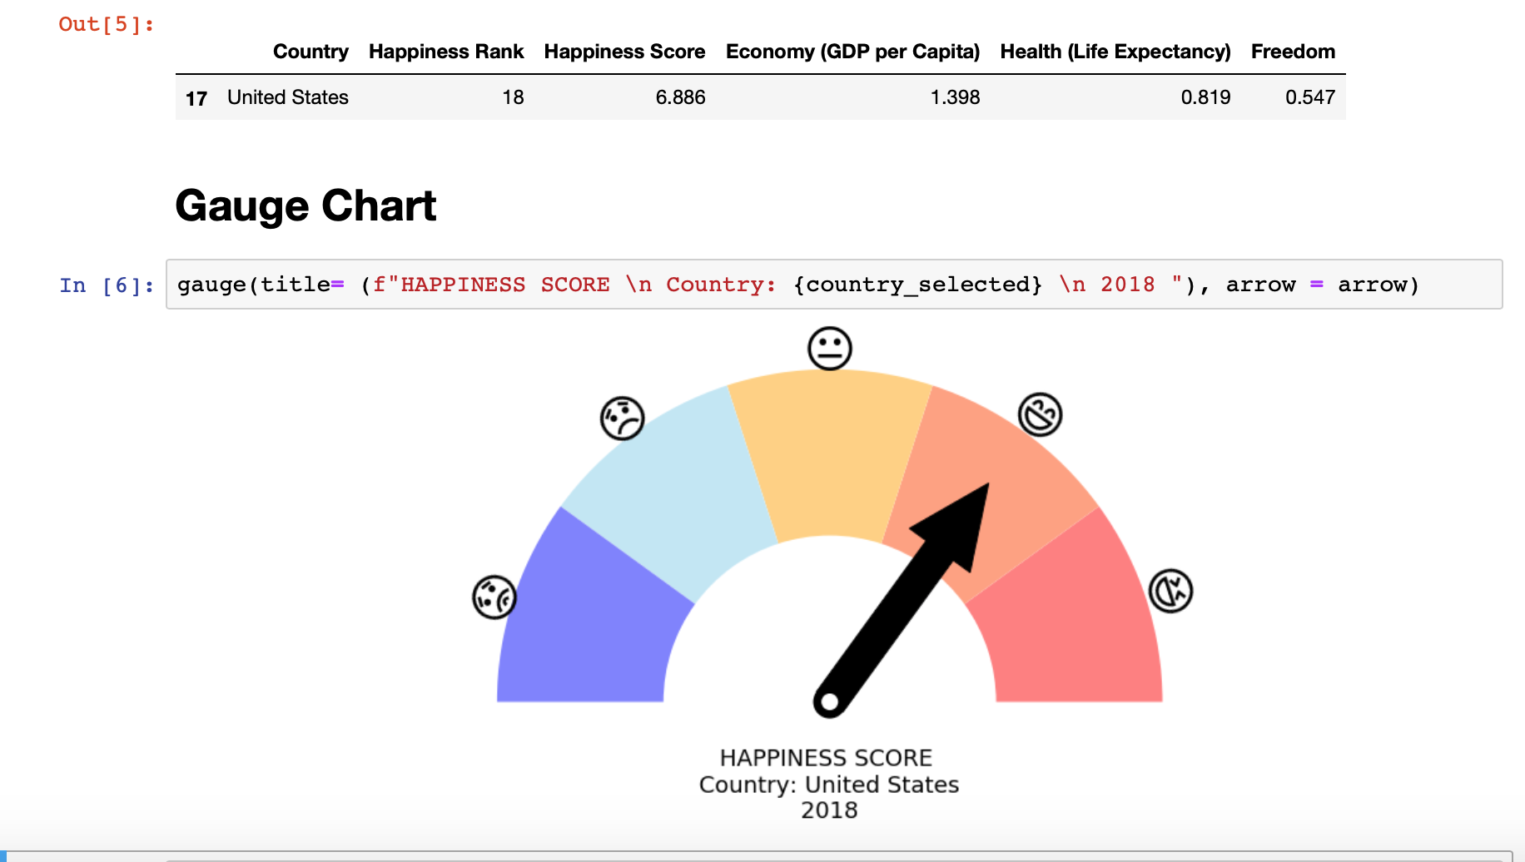
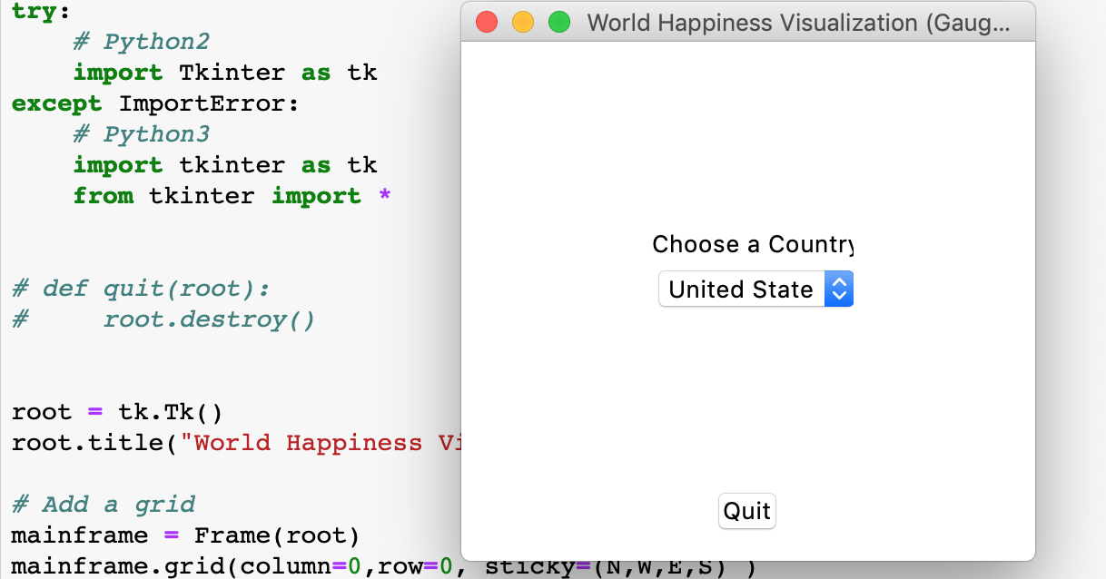
Happiness Score Gauge
Visualization with Matplotlib
Using Matplotlib's patches to create Arcs, Sectors and Arrow of this gauge chart.
Using Emoji to labels each Sectors.
Python GUI
Using built-in Python module Tkinter to create simple OptionMenu Widget (combobox).
Notes:
Talking points:
Demo in Jupyter Notebook

Slide 13
Conclusion
GDP, freedom, and life expectancy all show a positive correlation with happiness with GDP showing the greatest impact.
Neither literacy % or infant mortality rate show any correlation with happiness
The happiest regions of the world appear to be in Europe, North and South America, Australia and New Zealand. Africa appears to contain the lowest overall happiness scores.
Identifying reliable sources of data can sometimes be challenging, ie. World Bank Data

